Slide 1
Threaded Binary Tree

Slide 2
Threads
In linked representation of Binary tree,
Many of the nodes have NULL value in their left and right pointers.
It would be good to use these pointer fields to keep some other information.
Useful for Traversal Operation

Slide 3
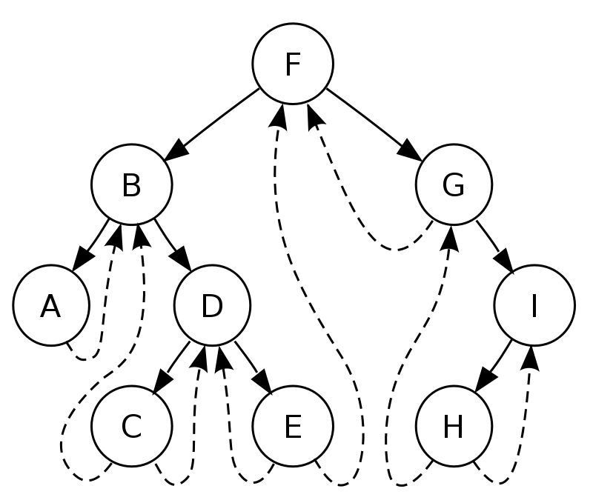
Threads
These NULL pointers can be used to point nodes higher in the tree.
Such pointers are called Threads

Slide 4
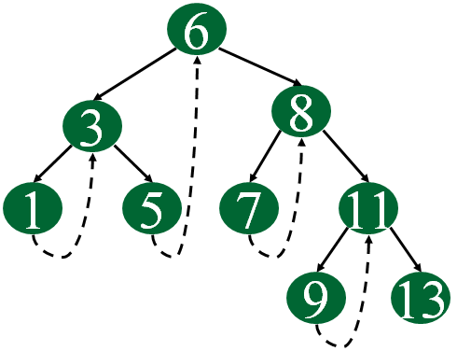
Threaded Binary Tree
A binary tree which implements such pointers is called threaded Binary tree
The dotted lines represent threads
Single Threaded Binary Tree

Slide 5
Threads
Threads corresponding to 3 Traversals:
Preorder
Postorder
Inorder

Slide 6
Inorder Threading
Two types-
One Way Inorder Threading/ Single Threaded
Two Way Inorder Threading / Double Threaded

Slide 7
Inorder Threading-
One Way Inorder Threading
Each NULL right pointer is altered to contain a thread to point to that node's inorder successor.
Two Way Inorder Threading
Each NULL right pointer is altered to contain a thread to point to that node's inorder successor.
+
Each NULL left pointer is altered to contain a thread to point to that node's inorder predecessor.

Slide 8
Inorder Threading
Two types-
Right In-Threaded Binary Tree
Left In-Threaded Binary Tree
Fully In-Threaded Binary Tree

Slide 9
Inorder Threading-
Right In-Threaded Binary Tree
If we use right field of the node to take the thread
Left In-Threaded Binary Tree
If we use left field of the node to take the thread
Fully In-Threaded Binary Tree/In-Threaded Tree
If both left and right fields are used for threading

Slide 10
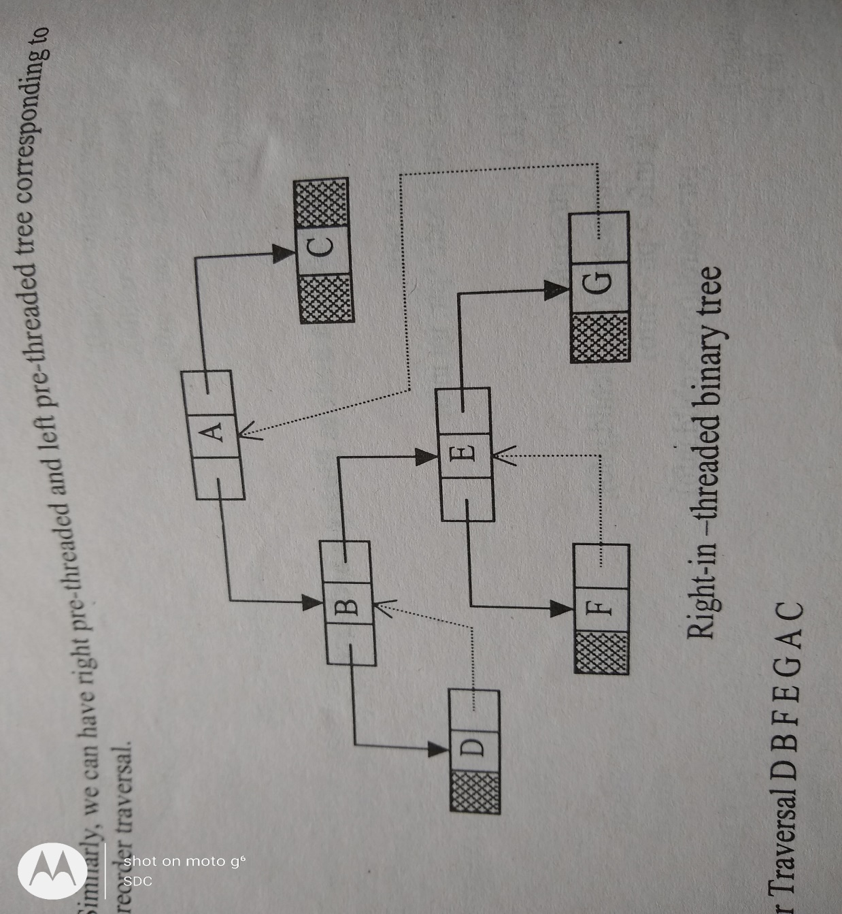
Right In-Threaded Binary Tree
Each NULL right pointer is altered to contain a thread to point to that node's inorder successor.
For Eg-
Thread of D points to B which is inorder successor of D
Inorder Traversal-
DBFEGAC

Slide 11
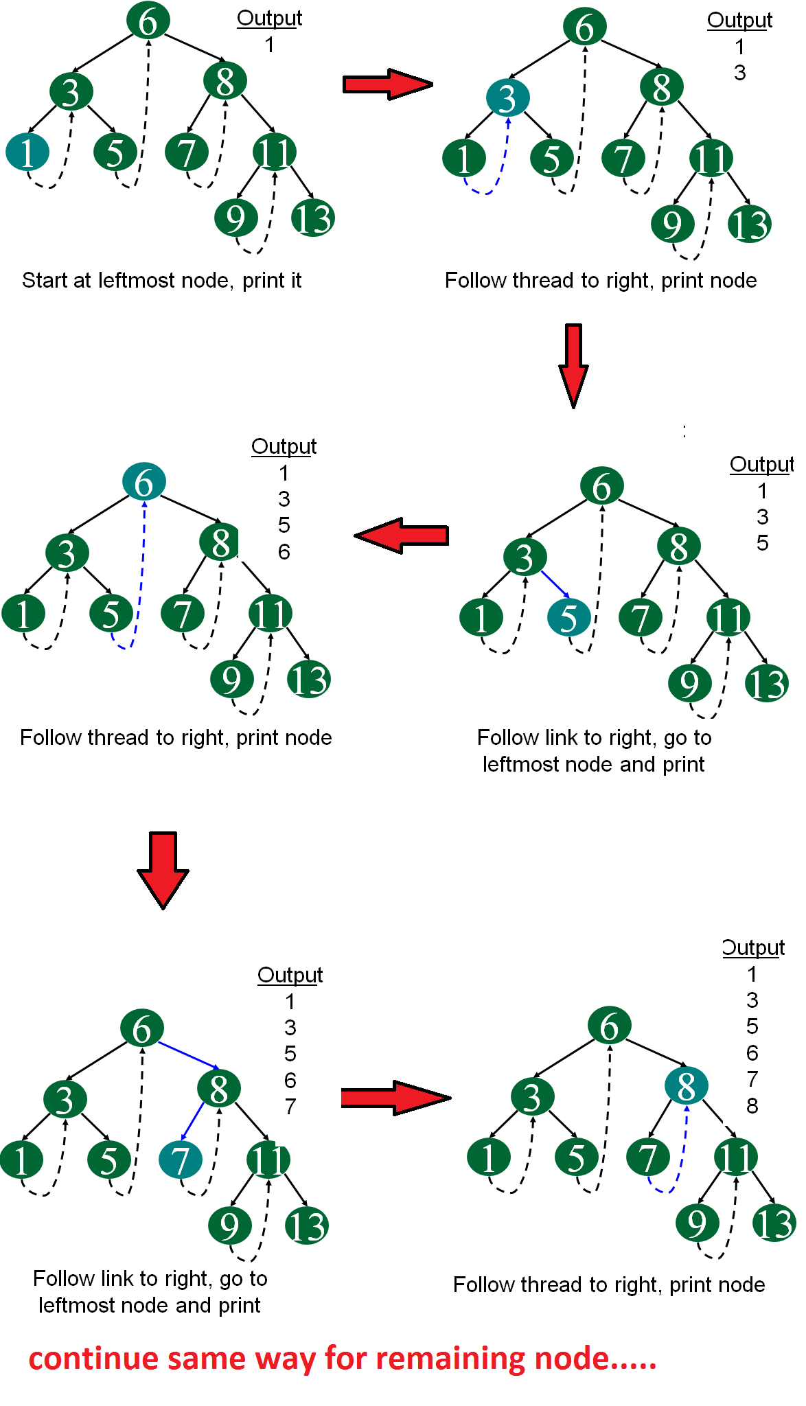
Right In-Threaded Binary Tree
Courtesy:https://www.geeksforgeeks.org/threaded-binary-tree/

Slide 12
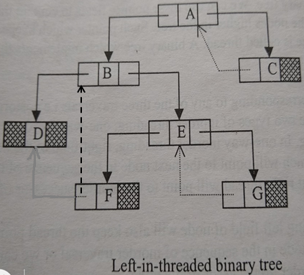
Left In-Threaded Binary Tree
Each NULL left pointer is altered to contain a thread to point to that node's inorder predecessor.
For Eg-
Thread of F points to B which is inorder predecessor of F
Inorder Traversal-
DBFEGAC

Slide 13
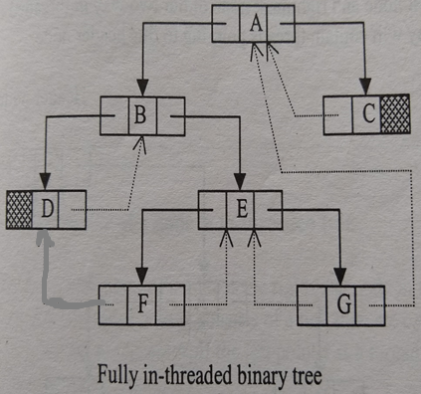
Fully In-Threaded Binary Tree
If both left and right fields are used for threading
For eg-
Left thread F points to B, inorder predeccessor
Right thread F points to E, inorder successor
Inorder Traversal-
DBFEGAC

Slide 14
Preorder Threading-
Similarly , we can have Right Pre-threaded and Left Pre-threaded Tree corresponding to the Preorder Traversal.

Slide 15
Structure of a node in 2way In Threaded Tree
typedef enum {thread,link} boolean;
struct node
{
struct node *left_ptr;
boolean left;
int info;
struct node *right_ptr;
boolean right;
};

Slide 16
Structure of a node in 2way In Threaded Tree
typedef enum {thread,link} boolean;
struct node
{
struct node *left_ptr;
boolean left;
int info;
struct node *right_ptr;
boolean right;
};
Two boolean numbers
left
right
to differentiate between a thread and link

Slide 17
Enumeration
An enumerated data type
Enumeration
Enum

Slide 18
Enumeration What?
Data type consisting of a set of named values called elements, members or enumerators of the type

Slide 19
Enumeration
Eg-
enum e_tag {a,b,c,d=20,e,f,g=20,h}var;
In absence of initialization , the values assigned start at Zero and increase
If we do not explicitly assign values to enum names, the compiler by default assigns values starting from 0.
a=0
b=1
c=2
d=20
e=21
f=22
g=20
h=21

Slide 20

Enumeration
#include <stdio.h>
enum day {sunday, monday, tuesday, wednesday, thursday, friday, saturday};
int main()
{
enum day d = thursday;
printf("The day number stored in d is %d", d);
return 0;
}
Output-

Slide 21
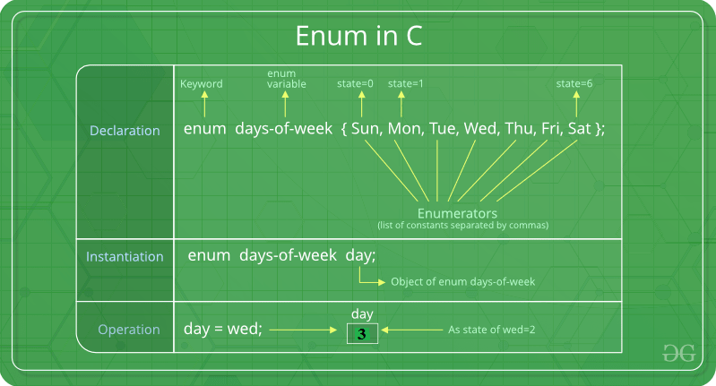
Enumeration

Slide 22

Enumeration
#include <stdio.h>
enum day {sunday = 1, monday, tuesday = 5,
wednesday, thursday = 10, friday, saturday};
int main()
{
printf("%d %d %d %d %d %d %d", sunday, monday, tuesday,wednesday, thursday, friday, saturday);
return 0;
}
Output-

Slide 23
Enum used-
typedef enum {thread,link} boolean;
declares an enumeration datatype called boolean
thread=0
link=1

Slide 24
Structure of a node in 2way In Threaded Tree
These members can take values thread or link
left =link, pointer left_ptr points to left child of the node
left=thread, pointer left_ptr is a thread pointing to inorder predecessor of the node
right=link, pointer right_ptr points to right child of the node
right=thread, pointer right_ptr is a thread pointing to inorder successor of the node

Slide 25
In-Threaded Tree
In Inorder traversal
1st Node has no predecessor
Last Node has no Successor
Left pointer of Leftmost Node/1st Node=NULL
Right Pointer of Rightmost Node/ Last Node =NULL
Still NULL values…..
Solution?

Slide 26
Solution= In-Threaded Tree with Header Nodes

Slide 27
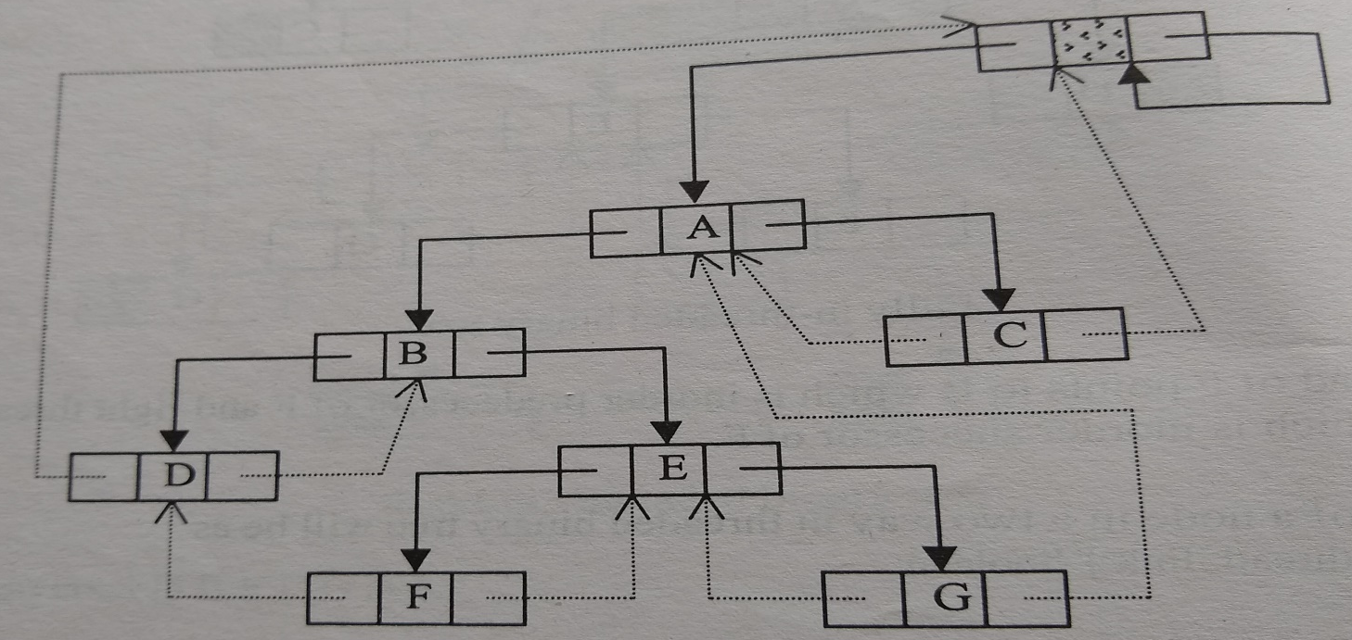
Solution= In-Threaded Tree with Header Nodes
A dummy node=Header Node is taken
Our tree will be the left subtree of this Header Node.
Left pointer of Header Node will point to the root node of our tree.
Header Node

Slide 28
Solution= In-Threaded Tree with Header Nodes
Now, Leftmost/Rightmost Node will not contain NULL
Will contain threads pointing to this Header Node
Header Node

Slide 29
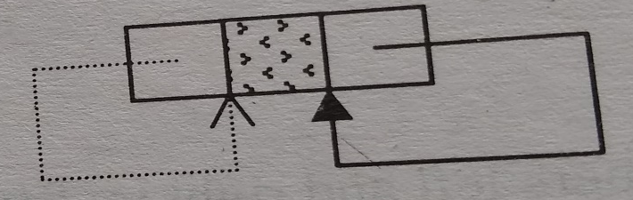
Solution= In-Threaded Tree with Header Nodes
When our tree will be empty then Left pointer of Header Node will be a thread pointing to itself.
Condition for empty In-threaded Tree with Header Node-
head->lchild=head
Header Node

Slide 30
Inorder Traversal in In-Threaded Binary Tree

Slide 31
Finding Inorder Successor of a node in In-threaded Node
The Inorder Successor of a node is the Leftmost node in the right subtree of that node
If the Right pointer of a node consists of a link then we can traverse the right subtree and find the inorder successor.
If the right pointer is a thread, then that thread will point to the inorder successor

Slide 32
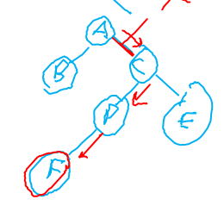
Finding Inorder Successor of a node in In-threaded Node
typedef enum {thread,link} boolean;
struct node
{
struct node *left_ptr;
boolean left;
int info;
struct node *right_ptr;
boolean right;
};
struct node * in_succ(struct node *ptr)
{
struct node *succ;
if(ptr->right==thread)
succ=ptr->right_ptr;
else
{
ptr=ptr->right_ptr;
while(ptr->left==link)
ptr=ptr->left_ptr;
succ=ptr;
}
return succ;
}

Slide 33
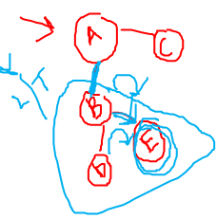
Finding Inorder Predeccessor of a node in In-threaded Node
The Inorder Predeccessor of a node is the Rightmost node in the left subtree of that node.
If the Left pointer of a node consists of a link then we can traverse the left subtree and find the inorder predeccessor.
If the left pointer is a thread, then that thread will point to the inorder predecessor

Slide 34
Finding Inorder Predecessor of a node in In-threaded Node
struct node * in_pred(struct node *ptr)
{
struct node *pred;
if(ptr->left==thread)
pred=ptr->left_ptr;
else
{
ptr=ptr->left_ptr;
while(ptr->right==link)
ptr=ptr->right_ptr;
pred=ptr;
}
return pred;
}
typedef enum {thread,link} boolean;
struct node
{
struct node *left_ptr;
boolean left;
int info;
struct node *right_ptr;
boolean right;
};

Slide 35
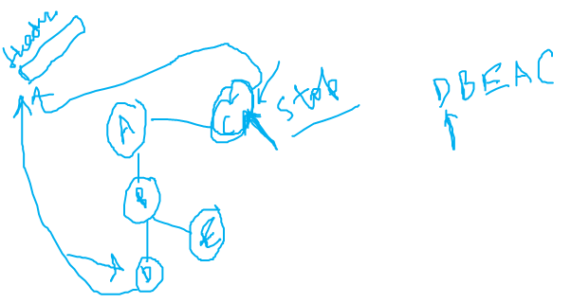
Inorder Traversal in Right In-threaded Node
Traverse the leftmost node of the tree
With the help of in_succ() function, find the inorder successor of each node and traverse it
Rightmost node of the tree is the last node in the inorder traversal and
Its right pointer is a thread points to the header node,
Hence we stop on reaching header node

Slide 36
Right In-Threaded Binary Tree
Courtesy:https://www.geeksforgeeks.org/threaded-binary-tree/

Slide 37
Inorder Traversal in In-threaded Node
inorder()
{
struct node *ptr;
if(head->left_ptr==head)
{
printf(“Tree is empty”);
return;
}
ptr=head->left_ptr;
/*Find the leftmost node and traverse it*/
while(ptr->left==link)
ptr=ptr->left_ptr;
printf(“%d”,ptr->info);
while(1)
{
ptr=in_succ(ptr);
if(ptr==head) /*If last node is reached*/
break;
printf(“%d”,ptr->info);
}/*end of while*/
}
Rightmost node of the tree is the last node in the inorder traversal and
Its pointer right poiter is a thread points to the header node,
Hence we stop on reaching header node

Slide 38
AVL Trees

Slide 39
AVL Trees
Why is it called so?

Slide 40
AVL Trees
Why is it called so?
Russian Mathematician G.M. Adelson Velskii and E.M . Landis came with a new technique for balancing binary search tree
Called AVL trees on their names.

Slide 41
AVL Trees
Balanced binary search tree
A binary search tree where height of left and right subtree of any node will be with maximum difference 1

Slide 42
AVL Trees
Each node has a balance factor.
Balance Factor=Height of Left subtree-Height of Right Subtree

Slide 43
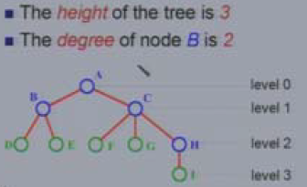
Tree
Basic Terminology-
Height -
Maximum level of any leaf in the tree.

Slide 44
AVL Trees
Right Heavy Node/Right High
If Height of right subtree is one more than height of its left subtree.
Left Heavy Node/Left High
If Height of its left subtree is one more than height of its right subtree
Balanced Node
If height of left subtree=Height of right subtree.

Slide 45
Balance factor –
Left High=1
Right High=-1
Balanced node=0

Slide 46
AVL trees- Node with Levels
A
0
1
B
C
1
2
D
E
F
G
2
3
H
I
For Node A=Left Heavy
Balance Factor=Height of Left Subtree-Height of Right Subtree
Balance Factor=3-2=1

Slide 47
AVL tree with Balance Factor
A
1
1
B
C
0
0
D
0
E
F
0
G
0
0
H
0
I
For Node A=Left Heavy
Balance Factor=Height of Left Subtree-Height of Right Subtree
Balance Factor=3-2=1

Slide 48
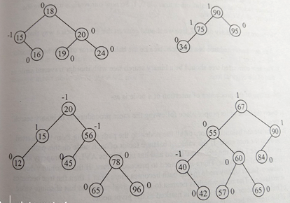
Binary Search Trees which are AVL Trees

Slide 49
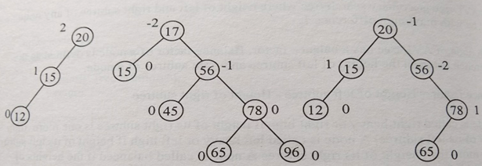
Binary Search Trees which are not AVL Trees

Slide 50
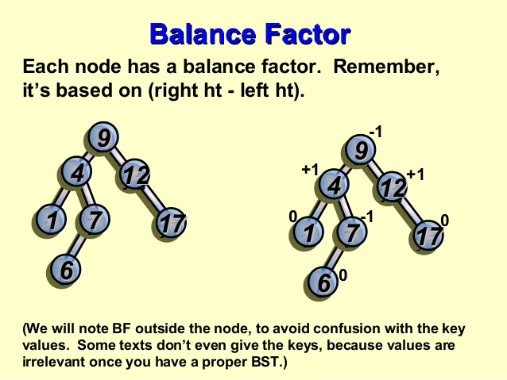
Calculate the Balance factor

Slide 51
Calculate the Balance factor
1
-1
-1
0
1
0
0

Slide 52
Insertion in AVL Trees–
Similar to Insertion in Binary Search Tree
Steps-
Insert the node at the proper place using same procedure as in BST
Calculate the balance factors of all the nodes on the path starting from the inserted node to the root node.
If the tree is balanced then there is no need to proceed further.
If absolute value of balanced factor of any node in this path >1 then the tree becomes unbalanced.
The node which is nearest to the inserted node & has absolute value of balance factor >1 is marked as Pivot node
We perform rotations about the pivot node

Slide 53
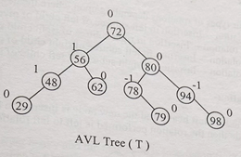
Insertion in AVL Trees–
Insert 52 in the given AVL tree

Slide 54
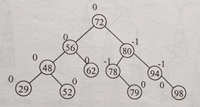
Insertion in AVL Trees–
After inserting 52,
the balance factors of some nodes changed
but tree is still balanced
Now Insert 35

Slide 55
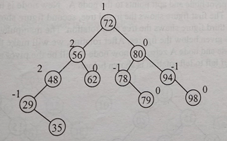
Insertion in AVL Trees–
After inserting 35,
Tree is unbalanced
Node 48 is unbalanced and
Is nearest to the inserted node, so it’s the Pivot Node
Rotations will be needed now

Slide 56
AVL Rotations–
4 types of Rotation:
Left to Left Rotation
Right to Right Rotation
Right to Left Rotation
Left to Right Rotation

Slide 57
AVL Rotations–
4 types of Rotation:
C to S Rotation
Child to Subtree Rotation
Left to Left Rotation
Right to Right Rotation
Right to Left Rotation
Left to Right Rotation

Slide 58
AVL Rotations–
4 types of Rotation depending upon where the new node is inserted:
Child to Subtree Relationship(Of Pivot Node)
Left to Left Rotation
Insertion in Left subtree of left child of Pivot Node
Right to Right Rotation
Insertion in Right subtree of right child of Pivot Node
Right to Left Rotation
Insertion in Left subtree of right child of Pivot Node
Left to Right Rotation
Insertion in right subtree of left child of Pivot Node

Slide 59
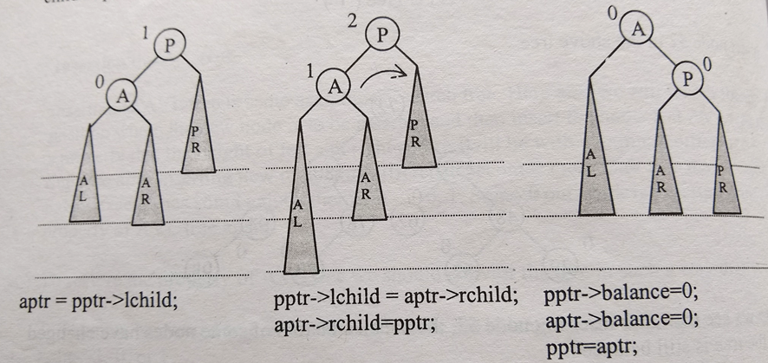
AVL Rotations–
Left to Left Rotation
P =Pivot node
A =Left Child of the Pivot Node
AL,AR=Left and Right Subtrees of Node A
PR=Right Subtree of Node P

Slide 60
AVL Rotations–
Left to Left Rotation
When the Pivot node is left heavy and
the new node is inserted in left subtree of the left child of pivot node then
the rotation performed is left to left rotation

Slide 61
AVL Rotations–
Left to Left Rotation(Clockwise about Pivot)
pointer pptr points to Pivot node
Pointer aptr points to A node
New node inserted in left Subtree of A
Clockwise Rotation about Pivot P is performed , Now A will be the pivot node
Pivot pulled down

Slide 62
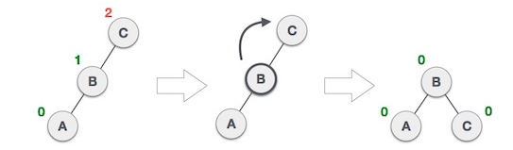
AVL Rotations–
Left to Left Rotation-Example
Left to Left Rotation(Clockwise about Pivot)

Slide 63
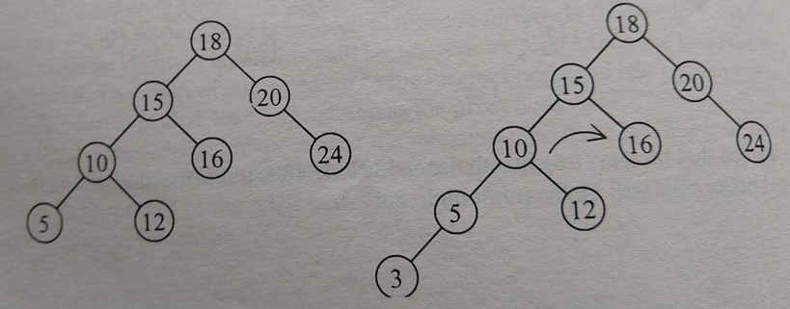
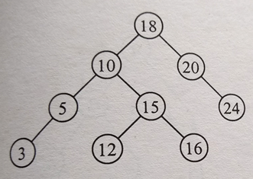
AVL Rotations–
Left to Left Rotation-Example- Insert 3
1
2
2
-1
1
-1
0
1
0
0
0
0
1
0
0
0
0

Slide 64
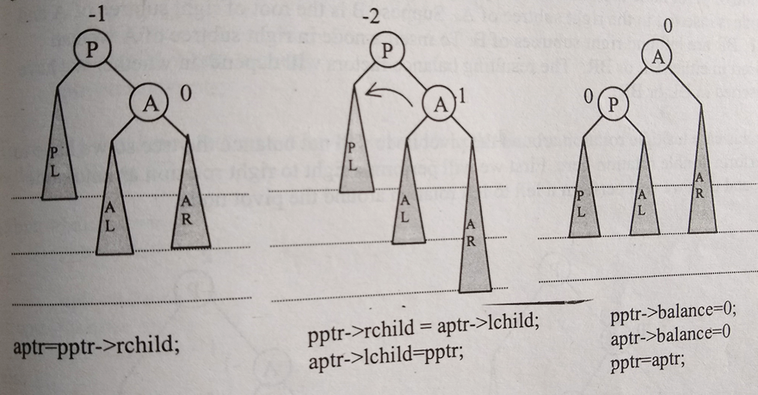
AVL Rotations–
Right to Right Rotation
P =Pivot node
A=Right Child of the Pivot Node
AL,AR=Left and Right Subtrees of Node A
PL=Left Subtree of Node P

Slide 65
AVL Rotations–
Right to Right Rotation(Anti –Clockwise about Pivot)
When the Pivot node is right heavy and
the new node is inserted in right subtree of the right child of pivot node then
the rotation performed is right to right rotation
Mirror image of Left to Left rotation

Slide 66
AVL Rotations–
Right to Right Rotation
pointer pptr points to Pivot node
Pointer aptr points to A node
New node inserted in right Subtree of A
Anticlockwise Rotation about Pivot P is performed, Now A will be the pivot node

Slide 67
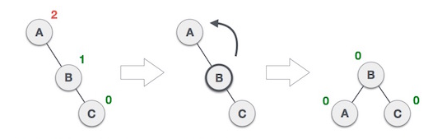
AVL Rotations–
Right to Right Rotation-Example
Anti –Clockwise about Pivot

Slide 68
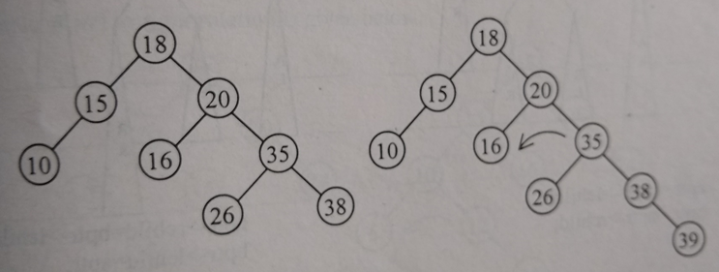
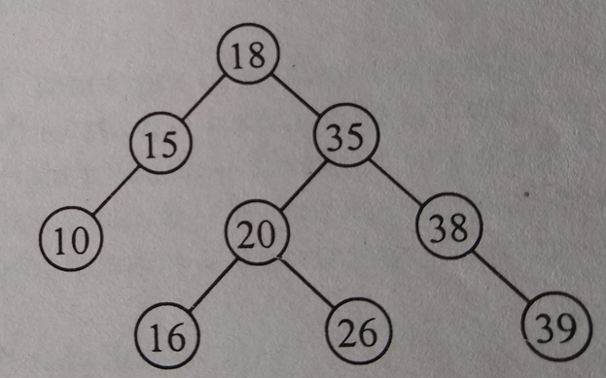
AVL Rotations–
Right to Right Rotation-Example-Insert 39
-2
1
-2
0
0
-1
-1
0
0

Slide 69
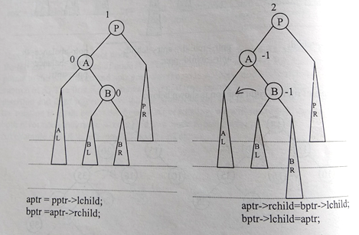
AVL Rotations–
Child to Subtree Relationship(Of Pivot Node)
Left to Right Rotation
New node is inserted in the right subtree of Left child A.
B is the root of right subtree of A
BL,BR are left and right subtrees of B.
To insert a node in right subtree of A, we can insert in either BL or BR.
The resulting balance factors depends on whether we have inserted in BL or BR

Slide 70
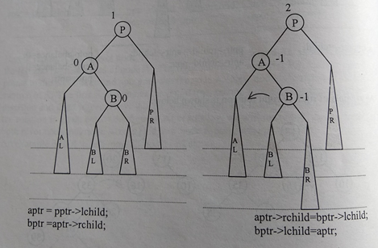
AVL Rotations–
Child to Subtree Relationship(Of Pivot Node)
Left to Right Rotation
When the Pivot node is left heavy and
the new node is inserted in right subtree of the left child of pivot node then
the rotation performed is left to right rotation

Slide 71
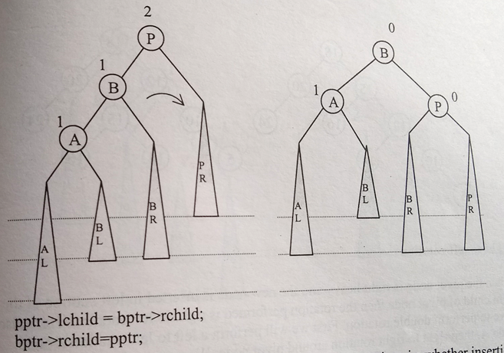
AVL Rotations–
Left to Right Rotation
Single rotation will not balance the tree
Double Rotation needed here
First Perform a Right to Right Rotation around node A

Slide 72
AVL Rotations–
Left to Right Rotation
Then Perform a Left to Left rotation around the pivot node

Slide 73
AVL Rotations–
Left to Right Rotation
First Perform a Right to Right Rotation around node A=>Anti –Clockwise
Then Perform a Left to Left rotation around the pivot node =>Clockwise

Slide 74
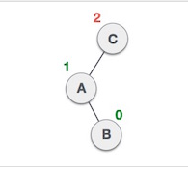
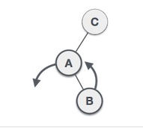
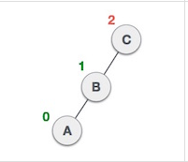
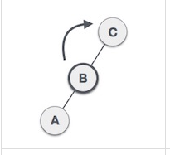
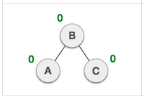
AVL Rotations–
Left to Right Rotation-Example
First Perform a Right to Right Rotation around node A=>Anti –Clockwise
Then Perform a Left to Left rotation around the pivot node =>Clockwise

Slide 75
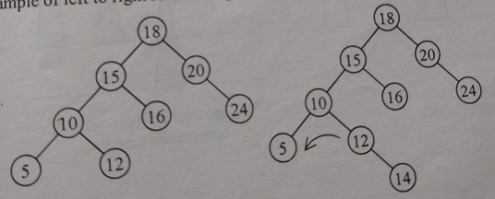
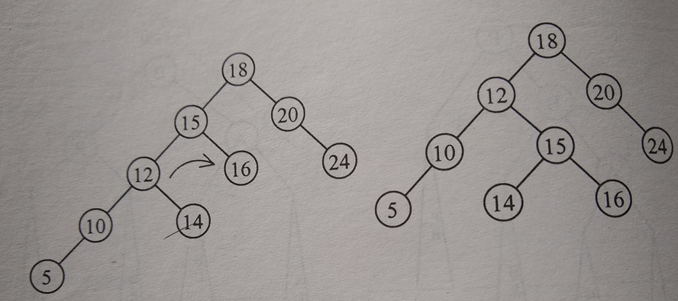
AVL Rotations–
Left to Right Rotation-Example
First Perform a Right to Right Rotation around node A=>Anti –Clockwise
Then Perform a Left to Left rotation around the pivot node =>Clockwise
Insert 14
2
-1
2
P
P
A
2
-1
A
0
P
-1
0
A
1
0
0
-1
1
0
0
0
0

Slide 76
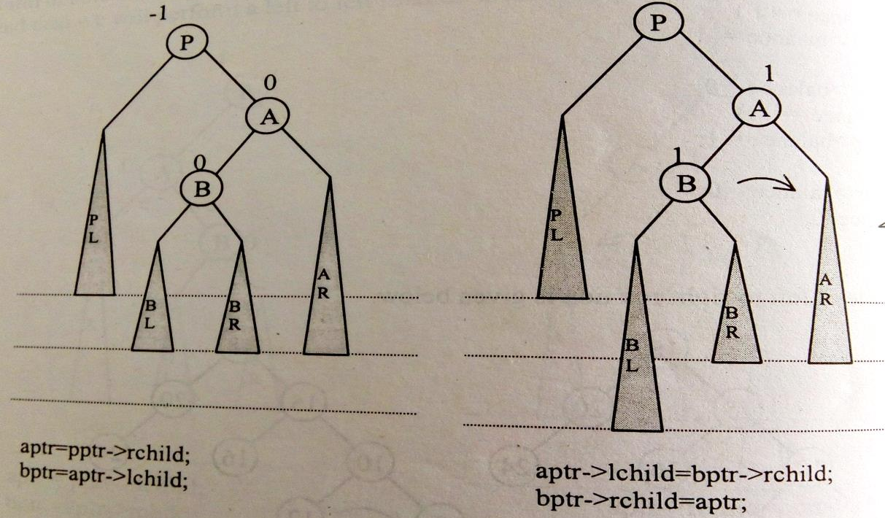
AVL Rotations–
Child to Subtree Relationship(Of Pivot Node)
Right to Left Rotation
When the Pivot node is right heavy and
the new node is inserted in left subtree of the right child of pivot node then
the rotation performed is right to left rotation

Slide 77
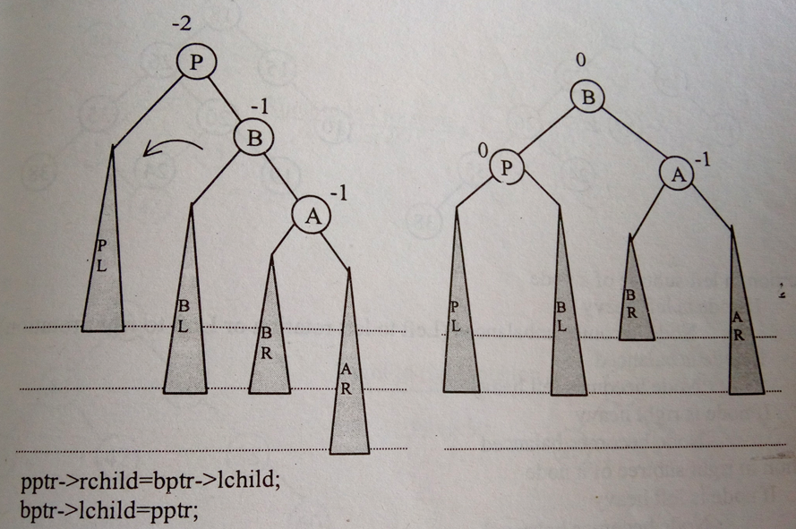
AVL Rotations–
Child to Subtree Relationship(Of Pivot Node)
Right to Left Rotation
Double Rotation needed
First Perform Left to Left Rotation around node A

Slide 78
AVL Rotations–
Right to Left Rotation
Then Right to Right rotation around pivot node P
Mirror image of Left to Right Rotation

Slide 79
AVL Rotations–
Right to Left Rotation
First Perform Left to Left Rotation around node A=>Clockwise
Then Right to Right rotation around pivot node P=>Anti-Clockwise

Slide 80
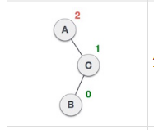
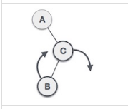
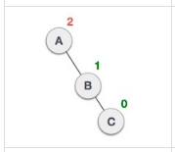
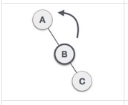
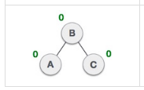
AVL Rotations–
Right to Left Rotation-Example
First Perform Left to Left Rotation around node A=>Clockwise
Then Right to Right rotation around pivot node P=>Anti-Clockwise

Slide 81
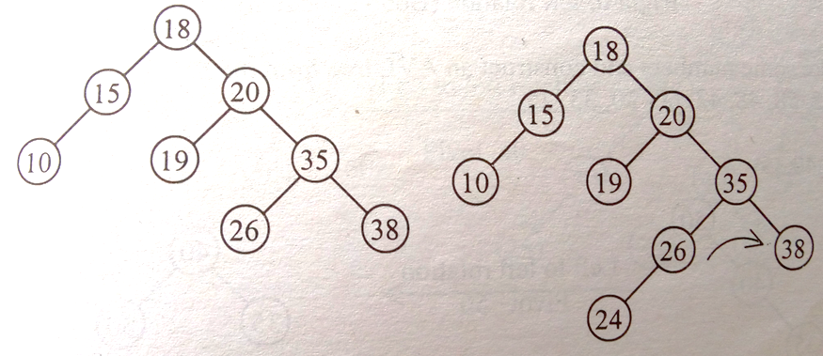
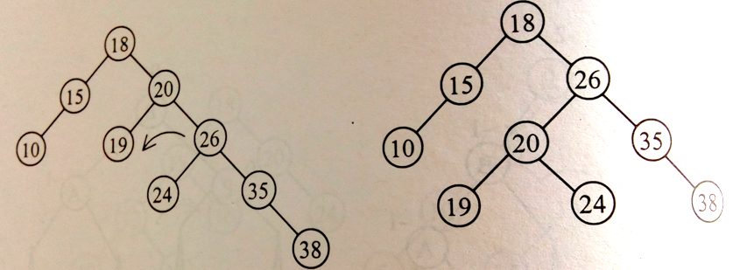
AVL Rotations–
Right to Left Rotation
Example-Insert 24
P
A
P
First Perform Left to Left Rotation around node A=>Clockwise
Then Right to Right rotation around pivot node P=>Anti-Clockwise

Slide 82
Construct an AVL tree by inserting the following numbers in the given sequence in an initially empty AVL tree. 15, 20, 24, 10, 13, 7, 30, 36

Slide 83

Construct an AVL tree by inserting the following numbers in the given sequence in an initially empty AVL tree. 15, 20, 24, 10, 13, 7, 30, 36
15
15
15
-2
-1
Insert 24-Right to Right Rotation
20
20
-1
0
24
0
20
0
15
0
24
20
+1
0
15
+1
24
0
10
0

Slide 84

Construct an AVL tree by inserting the following numbers in the given sequence in an initially empty AVL tree. 15, 20, 24, 10, 13, 7, 30, 36
Insert 13-Left to Right Rotation
20
+2
20
+2
15
+2
24
15
+2
24
0
0
13
10
+1
-1
13
0
10
0
20
+1
13
0
24
0
10
0
15
0

Slide 85
Construct an AVL tree by inserting the following numbers in the given sequence in an initially empty AVL tree. 15, 20, 24, 10, 13, 7, 30, 36
Insert 7-LL Rotation
13
-1
20
+2
13
10
20
-1
+1
24
0
+1
15
0
24
-1
10
+1
15
0
7
0
0
30
7

Slide 86
Construct an AVL tree by inserting the following numbers in the given sequence in an initially empty AVL tree. 15, 20, 24, 10, 13, 7, 30, 36
13
-1
13
-2
-1
-2
20
Insert 36-RR Rotation
10
+1
10
20
+1
0
-2
15
0
30
15
0
24
7
0
7
0
-1
24
36
30
0
0
0
36
Final AVL Tree

Slide 87
Construct an AVL Tree for the following sequence 9,8,7,15,16,17,18 Further mention the type of Rotation and the balance factors in each intermediated step

Slide 88
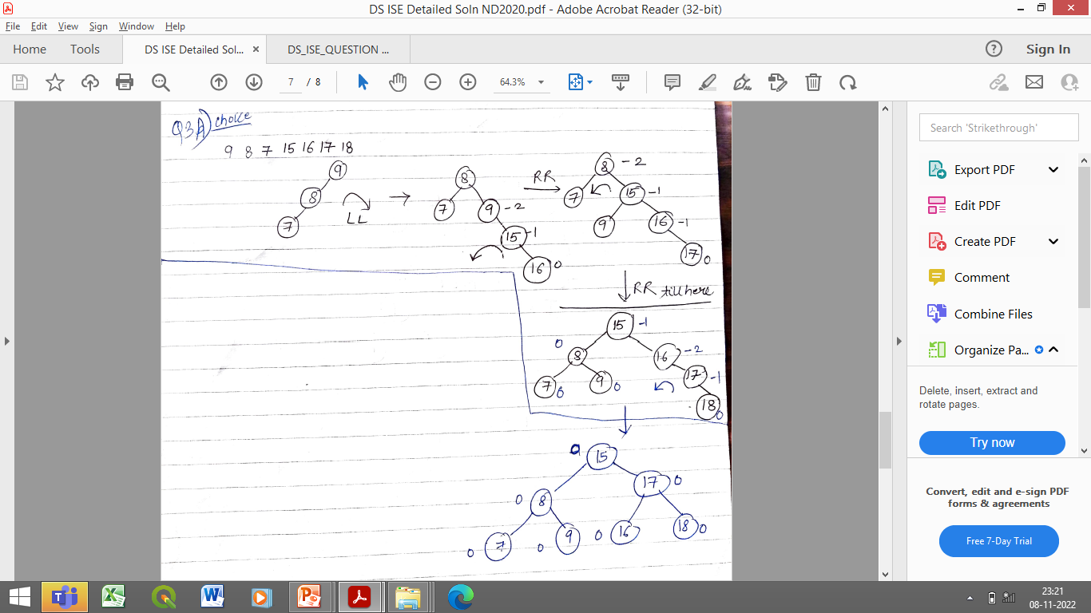
Construct an AVL Tree for the following sequence 9,8,7,15,16,17,18 Further mention the type of Rotation and the balance factors in each intermediated step

